Slide 1

Course Registration & Timetable Builder
26SC1101E Problem Solving Using Programming (Java)
V. Bhuvan Sai Teja (2620030671)
Shloka Bomma (2620030679)
Section 13 | KL University, B.Tech Freshmen
Notes:
Introduce yourselves and the project name. This is our end project for the PSP Java course. It covers all six course outcomes, CO1 to CO6.

Slide 2
The problem and our solution
The problem
Our solution
Students pick courses by hand, can go over the credit limit, and may end up with two classes at the same time.
A Java console app that registers courses, blocks credit and clash errors, and prints a weekly timetable.
1
12
6
Java file
menu options
course outcomes covered
Notes:
Explain the real-life problem: manual course selection leads to credit overflow and timetable clashes. Our program checks both automatically.

Slide 3






What the program can do
Add courses
Register and drop
Clash detection
Theory and Lab courses with validated input
Stay within the 24-credit limit
No two classes in the same day and slot
Weekly timetable
Search and sort
Files and reports
5 days x 5 slots grid printed in the console
Sort by ID, name or credits; search by name
Save, load and stream-based reports
Notes:
Walk through the six main features quickly. We will show them in the live demo later.

Slide 4
How the code is organised
main() menu loop
Custom exceptions
ClashException
CreditLimitException
IllegalArgumentException (built in)
Registration
Sort and search
Files and reports
Course (parent class, Comparable)
The two custom ones are checked exceptions that extend Exception
extends
LabCourse
Notes:
The whole program is one file. main() shows the menu. Registration has the rules, sorting and searching work on the course list, and files and reports save data and build summaries. Course is the parent class and LabCourse extends it.

Slide 5
CO1 and CO2: algorithm and control flow
1 Read input
2 Validate
3 Menu loop
4 switch
5 Show result
CO1 From problem to program
CO2 Control flow
Algorithm and flowchart in the README
Constants, variables and expressions
Scanner input, formatted output
Credits shown as total / 24
do-while menu runs until Exit
switch on the menu choice
if / else-if validation checks
while loops retry bad input
Notes:
CO1: we wrote the algorithm and flowchart in the README, and used constants, expressions and Scanner. CO2: the main menu is a do-while loop with a switch, and input is validated with if-else and while loops.

Slide 6
CO3: methods, recursion and arrays
static int totalCredits(int i) {
if (i == registered.size())
return 0; // base case
return registered.get(i).getCredits()
+ totalCredits(i + 1); // recursive
}
Mon
Tue
Wed
Thu
Fri
9:00
CS101
PH101
10:00
MA101
11:00
12:00
CS102L
Recursion adds up the registered credits
1-D arrays: DAYS and TIMES
Methods take parameters and return values
2-D array
Course[5][5]: days x time slots. A clash is a cell that is already filled.
Notes:
The recursive method has a base case (end of list) and a recursive case. The timetable is a 2-D array: rows are days, columns are time slots. If the cell is not empty, we throw a clash exception.

Slide 7
CO4: objects that fail safely
Classes and inheritance
try {
check(c);
registered.add(c);
} catch (ClashException
| CreditLimitException e) {
System.out.println(e.getMessage());
} finally {
System.out.println("done");
}
Course has private fields and getters
Overloaded constructors use this(...)
LabCourse extends Course, overrides getHours()
Polymorphism in action
2 custom checked exceptions, plus IllegalArgumentException for bad data
Course, 3 credits = 3 hours a week
LabCourse, 2 credits = 4 hours a week
Notes:
Course is the parent class and LabCourse extends it. LabCourse overrides getHours, that is polymorphism. Registration can fail in two ways, and each has its own exception. We use multi-catch and finally.

Slide 8



CO5: strings, algorithms and files
Strings
Library algorithms
File handling
StringBuilder builds the timetable
equalsIgnoreCase for IDs
split(",") parses file lines
contains() for name search
Collections.sort with Comparable
Comparator by name or credits
reversed() for high to low
Search by ID and by name
Files.writeString saves courses
Files.readAllLines loads them
Bad lines are skipped
Missing file is handled
Notes:
Strings: StringBuilder for the timetable text, split to read CSV lines. Algorithms: sorting with Comparable and Comparator. Files: we save courses, load them back, skip bad lines, and handle a missing file.

Slide 9
CO6: collections and streams
Predicate<Course> heavy =
c -> c.getCredits() >= 3;
courses.stream().filter(heavy)
.map(Course::getName).sorted()
.collect(Collectors.joining(", "));
What we used
ArrayList<Course> with generics
Map with groupingBy and counting
TreeSet of credit values
Lambda and Predicate
Method references (Course::getName)
Collectors.joining, count, sum
Optional for safe searching
Optional<Course> found = find(courses, id);
if (found.isEmpty()) ... // no null checks
Streams replace loops with steps: filter, map, sort, join.
Notes:
The stream pipeline filters, sorts, maps and prints course names. Optional avoids null checks. The reports method also shows a Map with groupingBy, a TreeSet, and a stream sum over the registered courses.

Slide 10
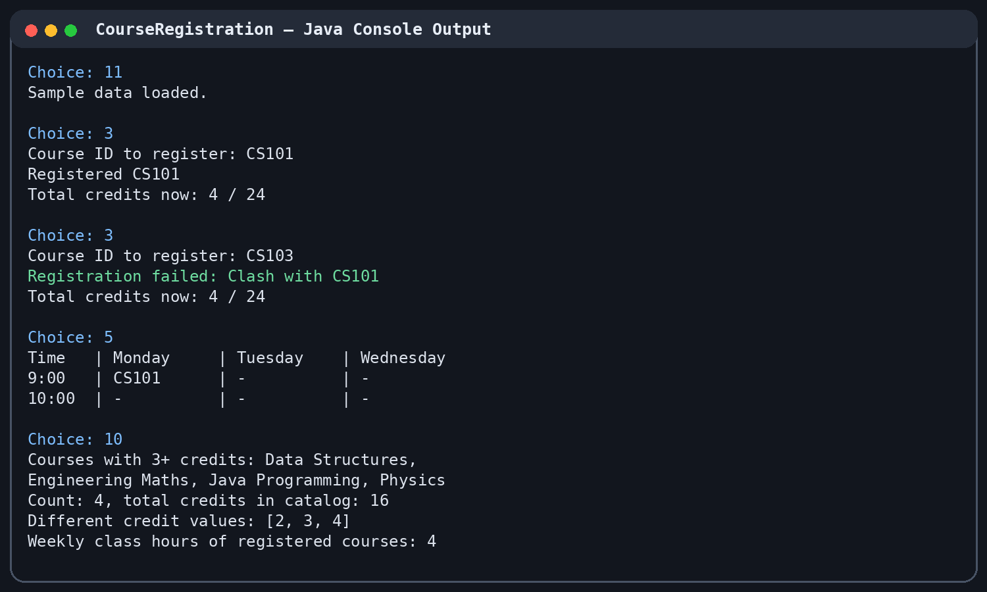
Live demo
Menu steps
11
Load sample data
3
Register CS101
3
Register CS103 (clash)
5
View the timetable
10
Run the reports
Notes:
Run the program live. Load the sample data, register CS101, then try CS103, which clashes. Then show the timetable and the stream report.

Slide 11
Where each CO is in the code
CO | Topics | Where in the code
CO1 | Algorithm, data types, expressions, Scanner I/O | readInt(), main(), README algorithm
CO2 | if-else, switch, do-while, for, while | main(), register(), showTimetable()
CO3 | Methods, recursion, 1-D and 2-D arrays | totalCredits(), DAYS, timetable
CO4 | Classes, constructors, inheritance, polymorphism, exceptions | Course, LabCourse, 2 exceptions
CO5 | Strings, sorting, searching, file I/O | sortCourses(), save(), load()
CO6 | Collections, lambdas, streams, Optional | find(), search(), reports()
Notes:
This table shows the evaluator exactly where to look for each course outcome. Every concept is also tagged in the source code with a comment like [CO6].

Slide 12
Team and thank you
V. Bhuvan Sai Teja
Shloka Bomma
Roll No. 2620030671
Roll No. 2620030679
Course classes, exceptions, registration
Menu, sorting, search, files, reports, README
Section 13 | Code, README and releases are on GitHub
Questions?
Notes:
Thank the evaluator. Mention the GitHub repository with the README and the commit history. Invite questions.

